Slide 1
STRATEGIC CRISIS SIMULATIONS
Notes:
The following slides contain audio describing GWUSCS. Transcripts of the audio appear here.

Slide 2
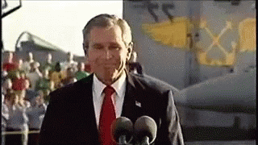
OUR MISSION
•Giving students professional skills for future careers in IA
•Promoting experiential learning and simulations/wargaming as a method of understanding IA issues
•Have fun!!
Note: we are a dues-free organization!
Notes:
SIMULATIONS DIRECTORATE:
Hello everyone, my name is William [LAST NAME] and I am the director of outreach for GWU Strategic Crisis Simulations. First, I'd like to say welcome and congratulations to everybody who was admitted to George Washington University. I definitely think that if you're interested in international affairs the Elliott School is 100% the place to go, and you can't go wrong with it.
But to talk about Strategic Crisis Simulations we are a student run organization affiliated with the Elliott School of International Affairs. We focus on foreign, domestic, and security policy issues. We hone the skills of our members through interactive and fun drills and simulations which, we'll go more in depth on on the following slide.
Since 2009, we have built a reputation as an educational and fun organization that not only widens student interests, but provides a network of mentors and affiliates that help further our members' prospects in defense intelligence, and policy, fields. Some of our partners include GW's Leadership, Ethics and Practice Initiiative, the Naval Academy at Annapolis, and we've also worked with DC's Naval ROTC Program. Thank you very much!

Slide 3
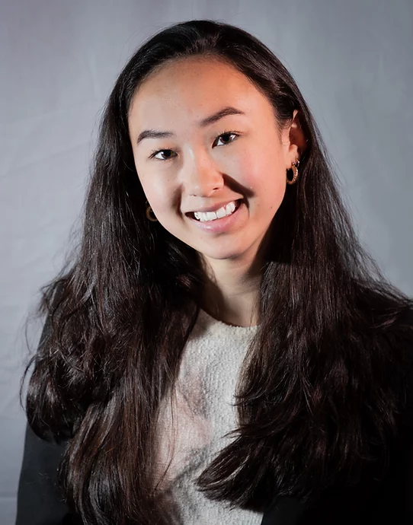
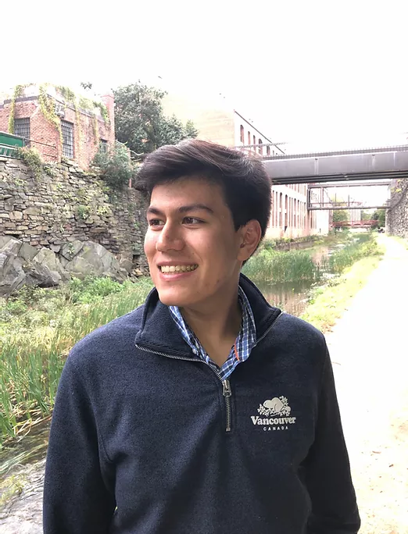
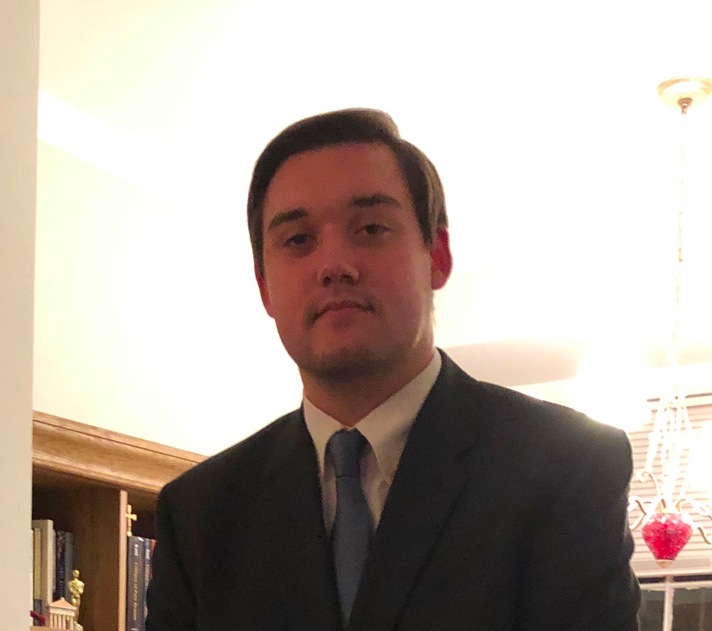
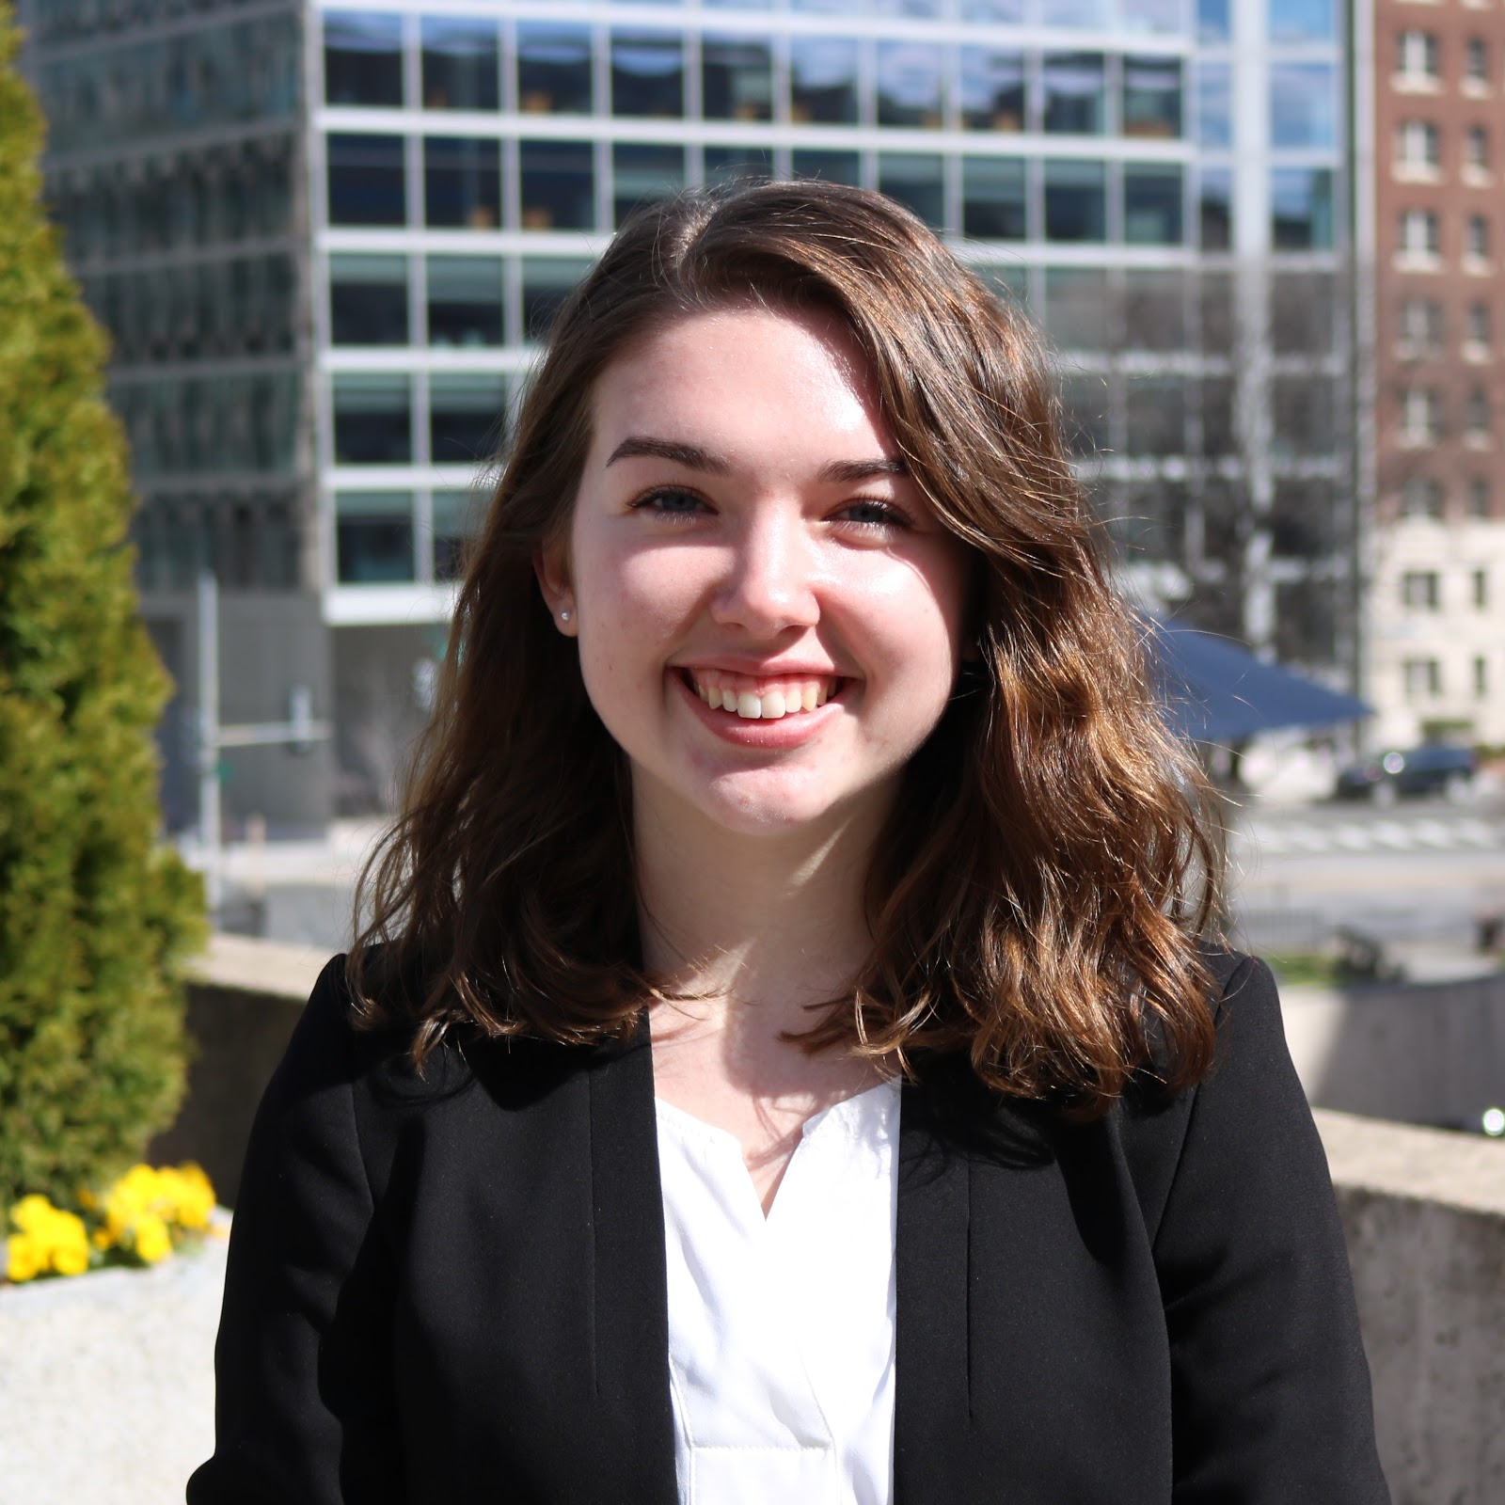
OUR EBOARD: ADMINISTRATIVE OFFICERS

Slide 4
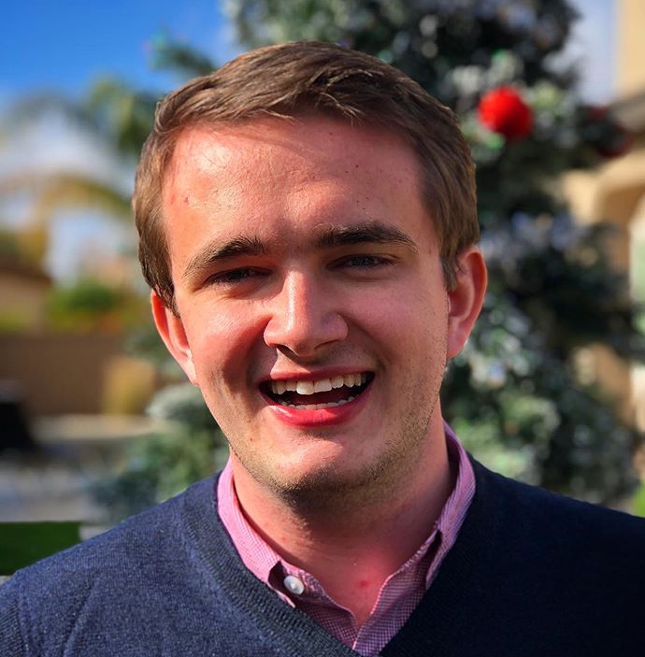
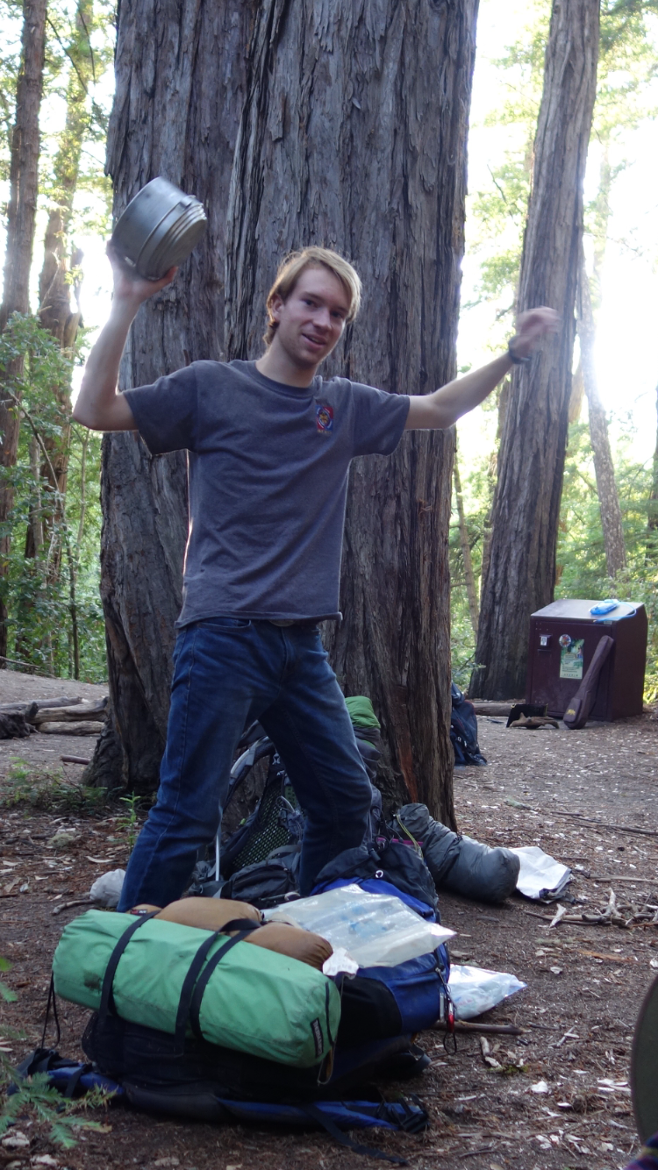
OUR EBOARD: PROGRAMMING COMMITTEE
Notes:
SIMULATIONS DIRECTORATE:
Hello everyone, my name is William [LAST NAME] and I am the director of outreach for GWU Strategic Crisis Simulations. First, I'd like to say welcome and congratulations to everybody who was admitted to George Washington University. I definitely think that if you're interested in international affairs the Elliott School is 100% the place to go, and you can't go wrong with it.
But to talk about Strategic Crisis Simulations we are a student run organization affiliated with the Elliott School of International Affairs. We focus on foreign, domestic, and security policy issues. We hone the skills of our members through interactive and fun drills and simulations which, we'll go more in depth on on the following slide.
Since 2009, we have built a reputation as an educational and fun organization that not only widens student interests, but provides a network of mentors and affiliates that help further our members' prospects in defense intelligence, and policy, fields. Some of our partners include GW's Leadership, Ethics and Practice Initiiative, the Naval Academy at Annapolis, and we've also worked with DC's Naval ROTC Program. Thank you very much!

Slide 5
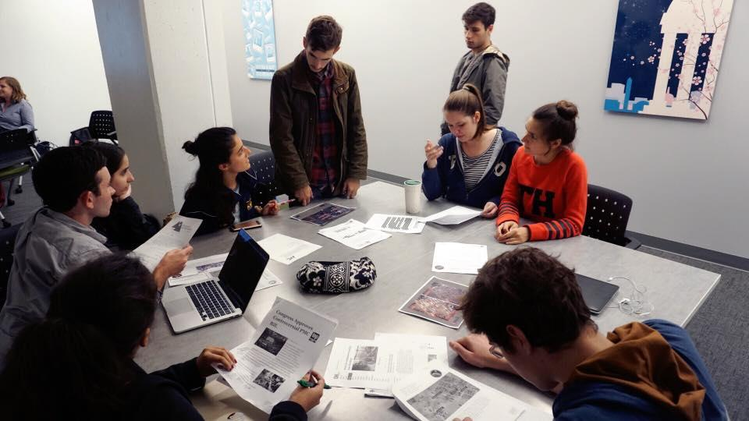
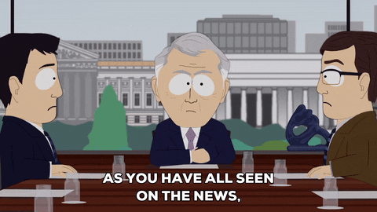
CRISIS DRILLS
•Small and short
•Similar to our simulations but more informal
•Very fun and more frequent than large simulations
Participants deliberating during a crisis drill
Notes:
AUDIO TRANSCRIPT:
The most common event held by SCS are crisis drills. 3 or 4 times a month on weeknights, participants engage in one to two hour simulations of international crises. Usually participants represent 3 to 6 different "teams" ranging from the WMATA to the CIA to the government of Taiwan, depending on what the crisis is. This crisis allow for participants to enjoy themselves on a weeknight while also engaging in hands-on learning. It is a unique opportunity to role-play scenarios of crisis on both the domestic and international scale. Participants are given introductory information as they arrive - no prep work is required, and then their actions drive the activity. Our control team responds to your actions with in-simulation consequences for you and other participants. It's a unique experience, hands-on experimental learning, and a good way to relax.
Additionally, once a month, the programming team puts on a social event, which can range from trivia nights to board games, as a much more relaxed environment to get to kick back and get to know each other. All of our events have a welcoming group of individuals who are always excited for new participants. We hope to see you at our weekly events next year.

Slide 6
ACADEMIC AND SOCIAL EVENTS
•Large network of professors and wargaming professionals that observe our simulations and offer advice to participants.
•Keep an eye out for interesting panel events and speakers this semester!
•Social Events: great chance to meet other members, chill stuff like game nights, movie nights, and Geopolitics against Humanity (our version of cards against humanity)
Notes:
SIMULATIONS DIRECTORATE:
Hello everyone, my name is William [LAST NAME] and I am the director of outreach for GWU Strategic Crisis Simulations. First, I'd like to say welcome and congratulations to everybody who was admitted to George Washington University. I definitely think that if you're interested in international affairs the Elliott School is 100% the place to go, and you can't go wrong with it.
But to talk about Strategic Crisis Simulations we are a student run organization affiliated with the Elliott School of International Affairs. We focus on foreign, domestic, and security policy issues. We hone the skills of our members through interactive and fun drills and simulations which, we'll go more in depth on on the following slide.
Since 2009, we have built a reputation as an educational and fun organization that not only widens student interests, but provides a network of mentors and affiliates that help further our members' prospects in defense intelligence, and policy, fields. Some of our partners include GW's Leadership, Ethics and Practice Initiiative, the Naval Academy at Annapolis, and we've also worked with DC's Naval ROTC Program. Thank you very much!

Slide 7
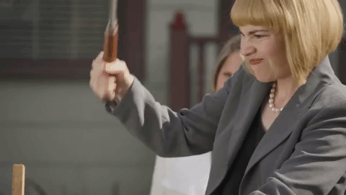
UNDERSTUDY PROGRAM
•Design your own drills! (mini-simulations)
•Work with Programming eboard members on design fall semester, run your drill in the spring semester
•Stay tuned for applications!
Notes:
SIMULATIONS DIRECTORATE:
Hello everyone, my name is William [LAST NAME] and I am the director of outreach for GWU Strategic Crisis Simulations. First, I'd like to say welcome and congratulations to everybody who was admitted to George Washington University. I definitely think that if you're interested in international affairs the Elliott School is 100% the place to go, and you can't go wrong with it.
But to talk about Strategic Crisis Simulations we are a student run organization affiliated with the Elliott School of International Affairs. We focus on foreign, domestic, and security policy issues. We hone the skills of our members through interactive and fun drills and simulations which, we'll go more in depth on on the following slide.
Since 2009, we have built a reputation as an educational and fun organization that not only widens student interests, but provides a network of mentors and affiliates that help further our members' prospects in defense intelligence, and policy, fields. Some of our partners include GW's Leadership, Ethics and Practice Initiiative, the Naval Academy at Annapolis, and we've also worked with DC's Naval ROTC Program. Thank you very much!

Slide 8
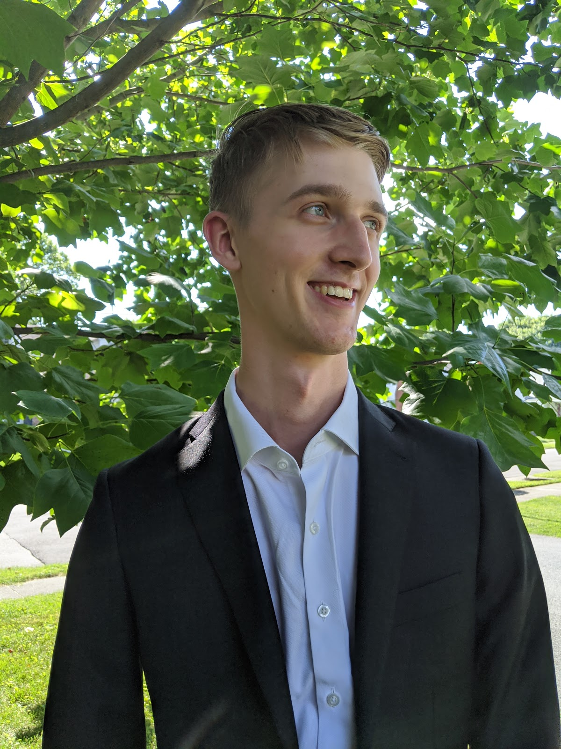
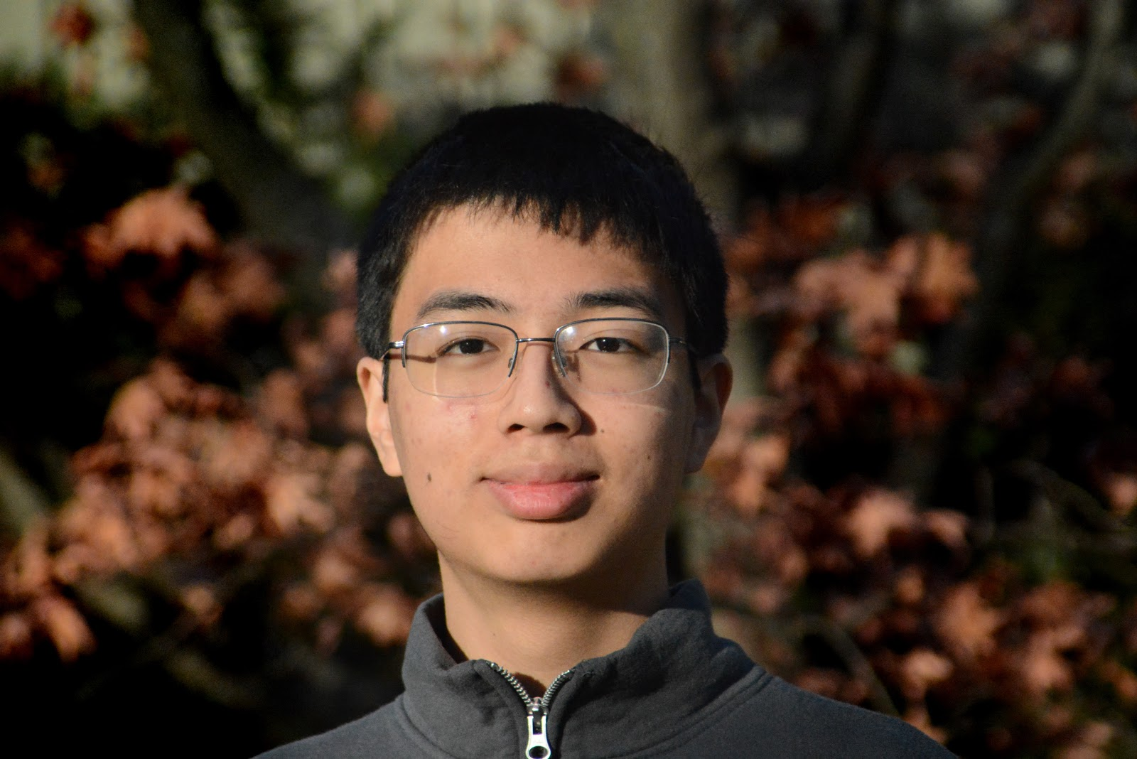
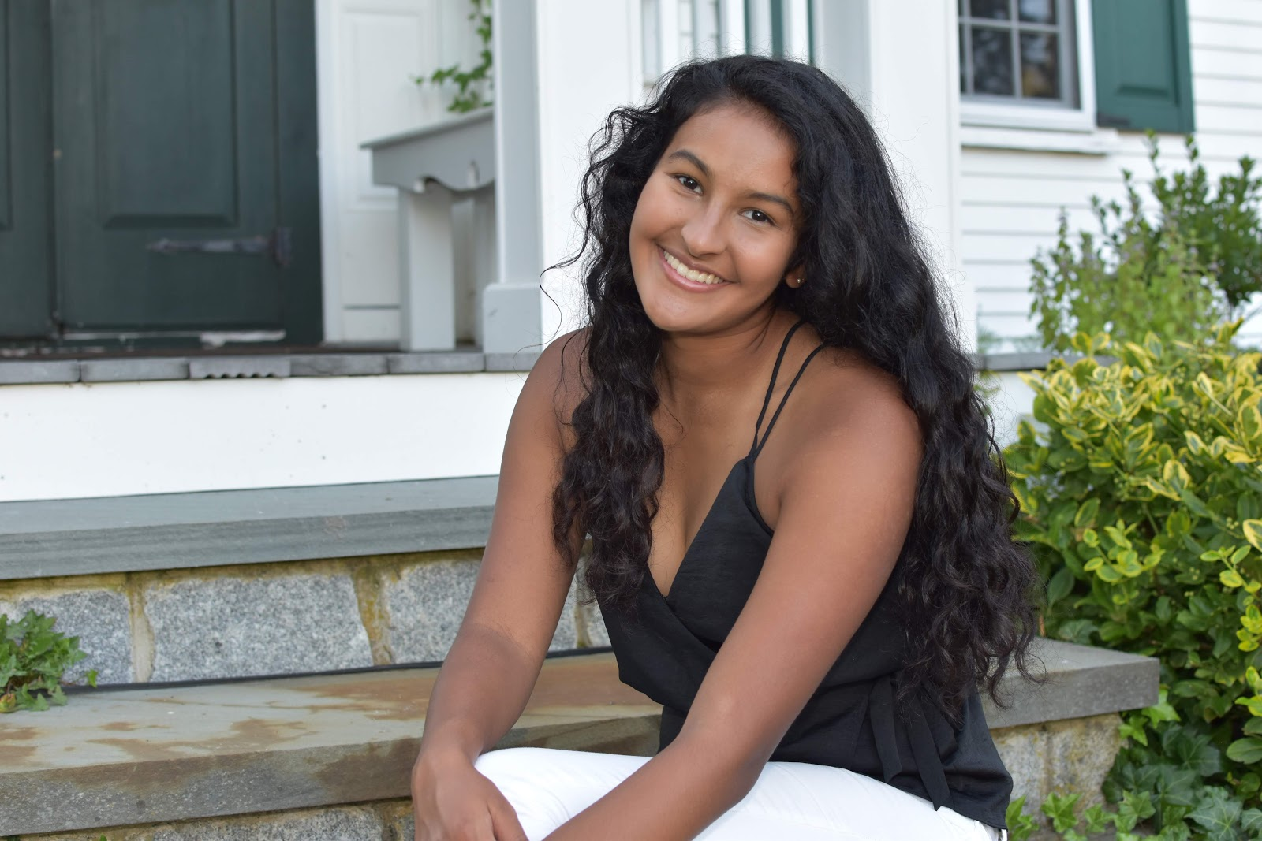
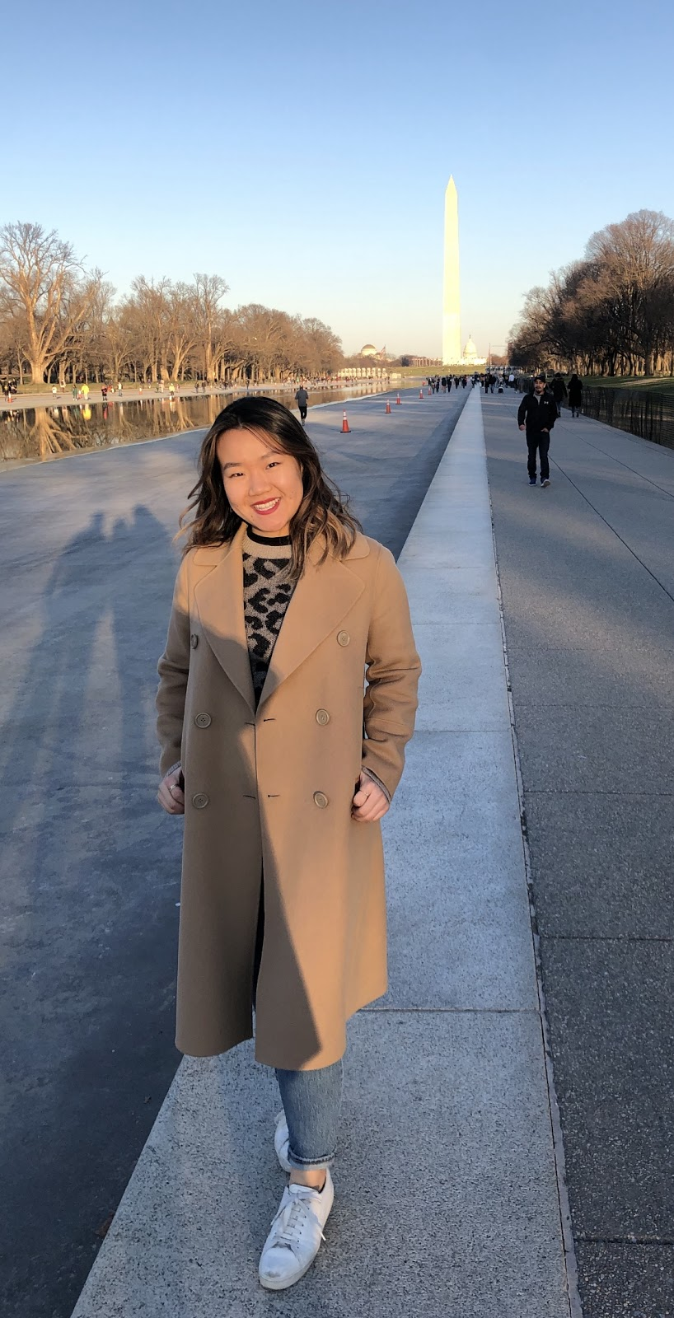
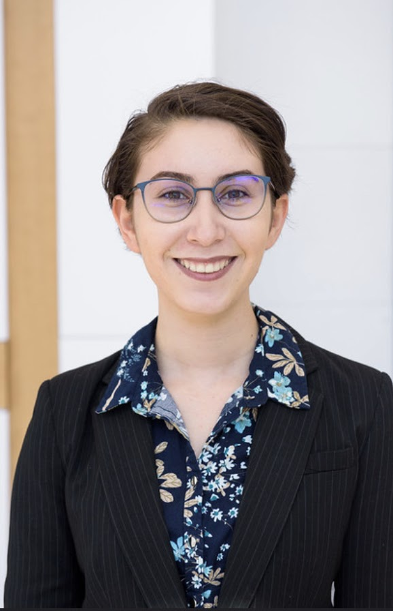
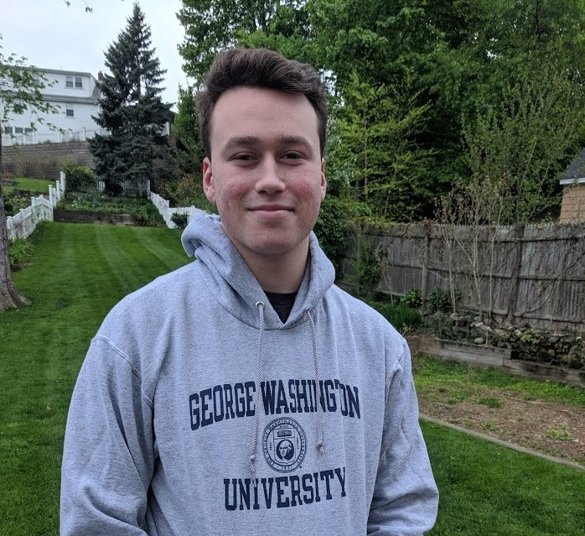
OUR EBOARD: DIRECTORATE
Notes:
SIMULATIONS DIRECTORATE:
Hello everyone, my name is William [LAST NAME] and I am the director of outreach for GWU Strategic Crisis Simulations. First, I'd like to say welcome and congratulations to everybody who was admitted to George Washington University. I definitely think that if you're interested in international affairs the Elliott School is 100% the place to go, and you can't go wrong with it.
But to talk about Strategic Crisis Simulations we are a student run organization affiliated with the Elliott School of International Affairs. We focus on foreign, domestic, and security policy issues. We hone the skills of our members through interactive and fun drills and simulations which, we'll go more in depth on on the following slide.
Since 2009, we have built a reputation as an educational and fun organization that not only widens student interests, but provides a network of mentors and affiliates that help further our members' prospects in defense intelligence, and policy, fields. Some of our partners include GW's Leadership, Ethics and Practice Initiiative, the Naval Academy at Annapolis, and we've also worked with DC's Naval ROTC Program. Thank you very much!

Slide 9
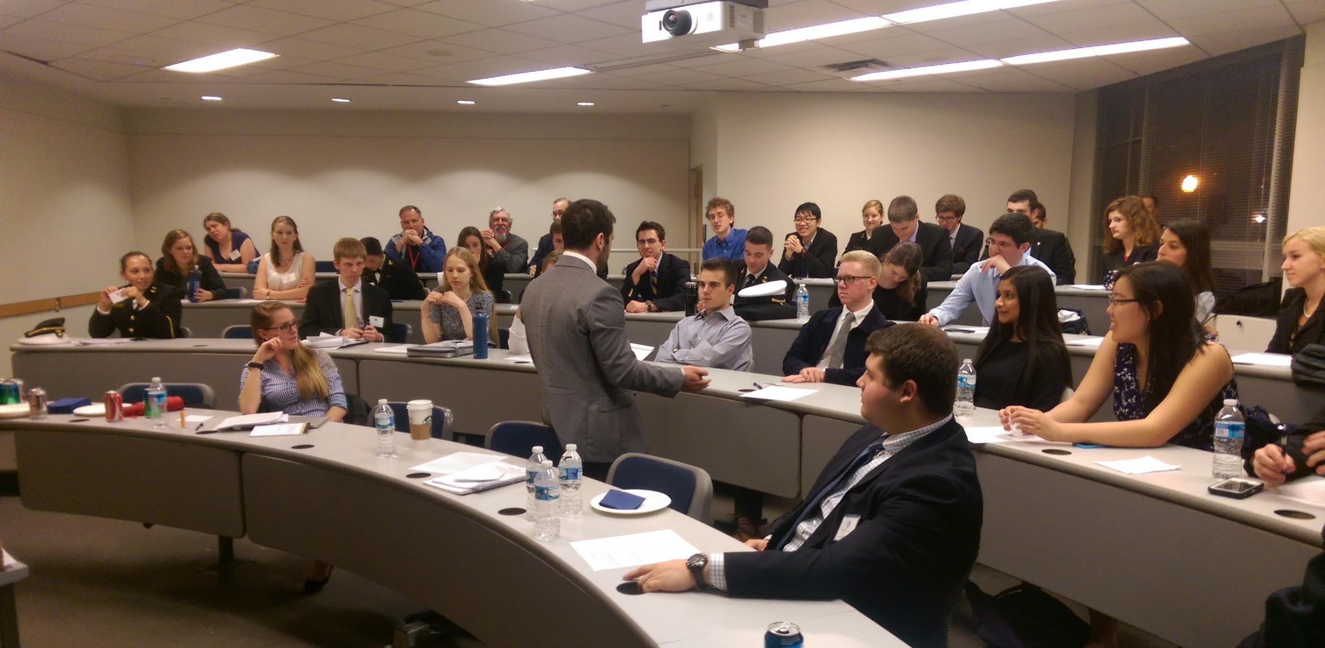
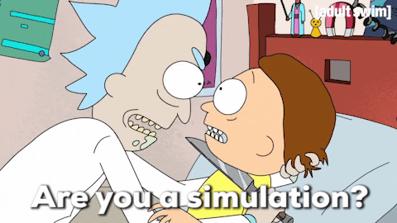
OUR SIMULATIONS
•Geopolitical wargames
•Large-scale (40-75 people)
•Realistic but speculative
•Multidimensional and highly interactive
•Spring 2021 simulation will *probably* be Rising Tides, U.S. - China conflict in the South China Sea
•^^Virtual or in-person
Notes:
AUDIO TRANSCRIPT:
Another important component of what SCS does is our Simulations Directorate, which holds two large-scale simulation events twice a semester. These events are geopolitical wargames in which participants play roles in U.S. government offices ranging from the National Security Council to USAID, and provide GW students with a practical opportunity to learn about government, crisis management, international conflict, and international diplomacy. In some of these events participants also play as foreign government officials; in the past this has included countries ranging from Colombia to China.
During our simulations, participants across our simulated offices are presented with a variety of fictional material detailing an evolving international crisis situation. Through negotiation and coordination with other offices and international actors represented by the control team, participants develop and execute policy to address the situation. The flashpoints underlying the scenario are designed to be multidimensional, and include problems that require whole-of-government responses.

Slide 10
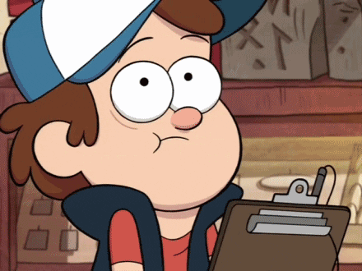
SIMULATIONS WRITING TEAM
Help Directorate (simulations design eboard members) design and run simulations!
Great for resume (skills/writing samples)
On hold for now (because COVID) but applications will be open later!
Notes:
SIMULATIONS DIRECTORATE:
Hello everyone, my name is William [LAST NAME] and I am the director of outreach for GWU Strategic Crisis Simulations. First, I'd like to say welcome and congratulations to everybody who was admitted to George Washington University. I definitely think that if you're interested in international affairs the Elliott School is 100% the place to go, and you can't go wrong with it.
But to talk about Strategic Crisis Simulations we are a student run organization affiliated with the Elliott School of International Affairs. We focus on foreign, domestic, and security policy issues. We hone the skills of our members through interactive and fun drills and simulations which, we'll go more in depth on on the following slide.
Since 2009, we have built a reputation as an educational and fun organization that not only widens student interests, but provides a network of mentors and affiliates that help further our members' prospects in defense intelligence, and policy, fields. Some of our partners include GW's Leadership, Ethics and Practice Initiiative, the Naval Academy at Annapolis, and we've also worked with DC's Naval ROTC Program. Thank you very much!

Slide 11
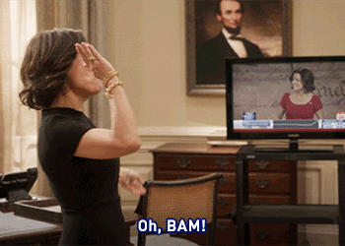
RUNNING/APPLYING FOR EXECUTIVE BOARD
Elected Positions
(Spring semester)
•President
•VP of Administration
•Director of Outreach
•VP of Programming
•Director(s) of Programming
Appointed Positions
•Vice President of Simulations
•Director of Simulations
•Deputy Director(s) of Simulations
^^(Spring semester)
•First-Year Representative
(Fall semester)
Notes:
SIMULATIONS DIRECTORATE:
Hello everyone, my name is William [LAST NAME] and I am the director of outreach for GWU Strategic Crisis Simulations. First, I'd like to say welcome and congratulations to everybody who was admitted to George Washington University. I definitely think that if you're interested in international affairs the Elliott School is 100% the place to go, and you can't go wrong with it.
But to talk about Strategic Crisis Simulations we are a student run organization affiliated with the Elliott School of International Affairs. We focus on foreign, domestic, and security policy issues. We hone the skills of our members through interactive and fun drills and simulations which, we'll go more in depth on on the following slide.
Since 2009, we have built a reputation as an educational and fun organization that not only widens student interests, but provides a network of mentors and affiliates that help further our members' prospects in defense intelligence, and policy, fields. Some of our partners include GW's Leadership, Ethics and Practice Initiiative, the Naval Academy at Annapolis, and we've also worked with DC's Naval ROTC Program. Thank you very much!

Slide 13
CONNECT WITH US
Website: gwuscs.org
Facebook: www.facebook.com/GWUSCS
Instagram: https://www.instagram.com/gwuscs
Engage (GW student org directory): https://gwu.campuslabs.com/engage/organization/strategic-crisis-simulations
Eboard office hours
(by appointment in Fall 2020)
Notes:
SIMULATIONS DIRECTORATE:
Hello everyone, my name is William [LAST NAME] and I am the director of outreach for GWU Strategic Crisis Simulations. First, I'd like to say welcome and congratulations to everybody who was admitted to George Washington University. I definitely think that if you're interested in international affairs the Elliott School is 100% the place to go, and you can't go wrong with it.
But to talk about Strategic Crisis Simulations we are a student run organization affiliated with the Elliott School of International Affairs. We focus on foreign, domestic, and security policy issues. We hone the skills of our members through interactive and fun drills and simulations which, we'll go more in depth on on the following slide.
Since 2009, we have built a reputation as an educational and fun organization that not only widens student interests, but provides a network of mentors and affiliates that help further our members' prospects in defense intelligence, and policy, fields. Some of our partners include GW's Leadership, Ethics and Practice Initiiative, the Naval Academy at Annapolis, and we've also worked with DC's Naval ROTC Program. Thank you very much!

Slide 14
QUESTIONS?
Sign up for our newsletter at: https://www.gwuscs.org/join-us
Further Questions? You can ask them here: https://docs.google.com/forms/d/e/1FAIpQLSexNu0xnLjSva1r3Xrv9825zuZLFYlluUf8C2u8xSaqH2n4AA/viewform?usp=sf_link
Questions will be answered periodically via. newsletter and website
Notes:
SIMULATIONS DIRECTORATE:
Hello everyone, my name is William [LAST NAME] and I am the director of outreach for GWU Strategic Crisis Simulations. First, I'd like to say welcome and congratulations to everybody who was admitted to George Washington University. I definitely think that if you're interested in international affairs the Elliott School is 100% the place to go, and you can't go wrong with it.
But to talk about Strategic Crisis Simulations we are a student run organization affiliated with the Elliott School of International Affairs. We focus on foreign, domestic, and security policy issues. We hone the skills of our members through interactive and fun drills and simulations which, we'll go more in depth on on the following slide.
Since 2009, we have built a reputation as an educational and fun organization that not only widens student interests, but provides a network of mentors and affiliates that help further our members' prospects in defense intelligence, and policy, fields. Some of our partners include GW's Leadership, Ethics and Practice Initiiative, the Naval Academy at Annapolis, and we've also worked with DC's Naval ROTC Program. Thank you very much!

